Slide 1
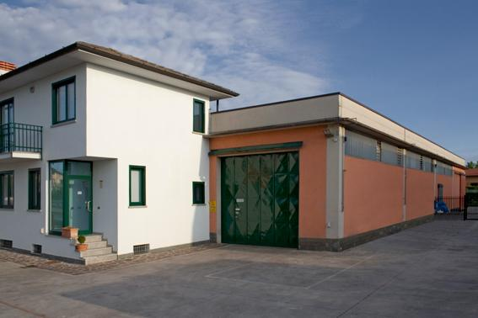
CER.CO.SAS TESTING DEPARTMENT

Slide 2
Who we are
Cer.Co.Sas di Fabio Galimberti begins its activity in the year 2002, giving assistance to manufacturers of PPE in order to achieve the mandatory CE Certification for their products
Furthermore, thanks to the skills of its owner, Cer.Co begins to look at environmental issues and, in particular, to issues related to information and training issues as requested by the legislation in force
In February 2013 Cer.Co begins the testing activities with its Testing Department, independent test house in Viale del Lavoro 22 in Spirano (BG). The Testing Department starts its activities with the anchor devices taking the opportunities given by the new EN 795:2012. The Testing Department is actually expanding into the world of PPE against falls from a heigth and others

Slide 3
Who we are
We are working hard in order to implement a quality system in compliance with ISO 17025
We are not accredited to ISO 17025
We apply, on a voluntary basis, the requirements of the ISO 17025 related to the traceability of the measurements, the calibration of the apparatus, the management of the samples, the confidentiality and the test report
Cer.Co. Sas Testing Department is qualified internally for providing its services to several notified Bodies in the field of PPE (Italcert, Anccp, Eurofins Tech)
We base our policy on customer oriented principles, among which the continuous research of a high competence and the continuous research of consistent and accurate test results

Slide 4
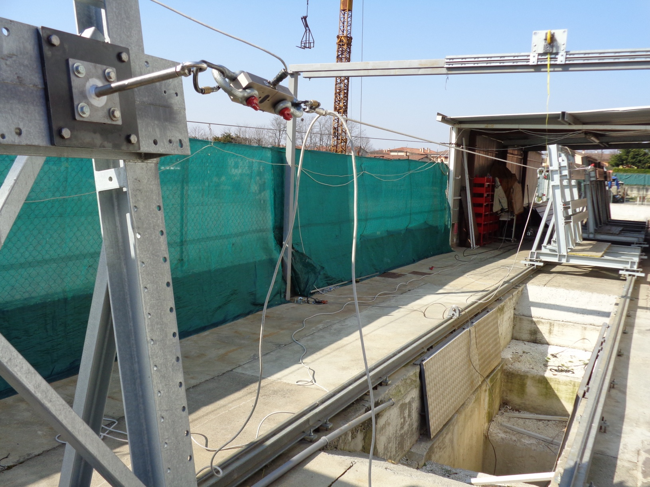
The test area

Slide 5
The test area
34.5 meters long test area
Four chassis running on rails in order to accept installations as per EN 795:2012 and CEN/TS 16415:2013
A hole 3.5 meters deep from feet level, together with the chassis, give about 5.2 meters of ground clearance
Direct application of the load (no pulleys)
Possibility to test type A, B, C, D devices (actually no type E)

Slide 6
The test area
Maximum single span: ~ 20 meters
Maximum permitted deflection (type C): ~ 240 mm
Maximum permitted heigth of devices (distance from the surface of the chassis, fixture or base material included ): ~ 700 mm
Possibility of testing corners (type C) using pulleys (to be evaluated case by case)

Slide 7
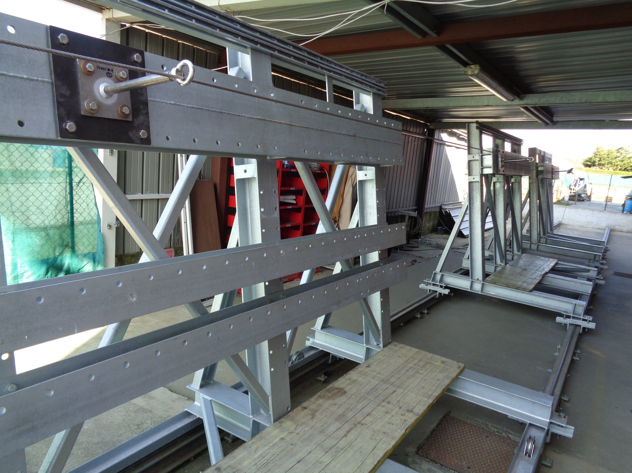
The Chassis

Slide 8
The Chassis
natural frequency of vibration in the vertical axis at the anchorage > 100 Hz in the worst point
It provides for a virtual plane with inclination 100° from the horizontal
It can accept anchor devices with direct installation (through fixtures)
It can accept anchor devices installed on panels up to 1440x2500 mm

Slide 9
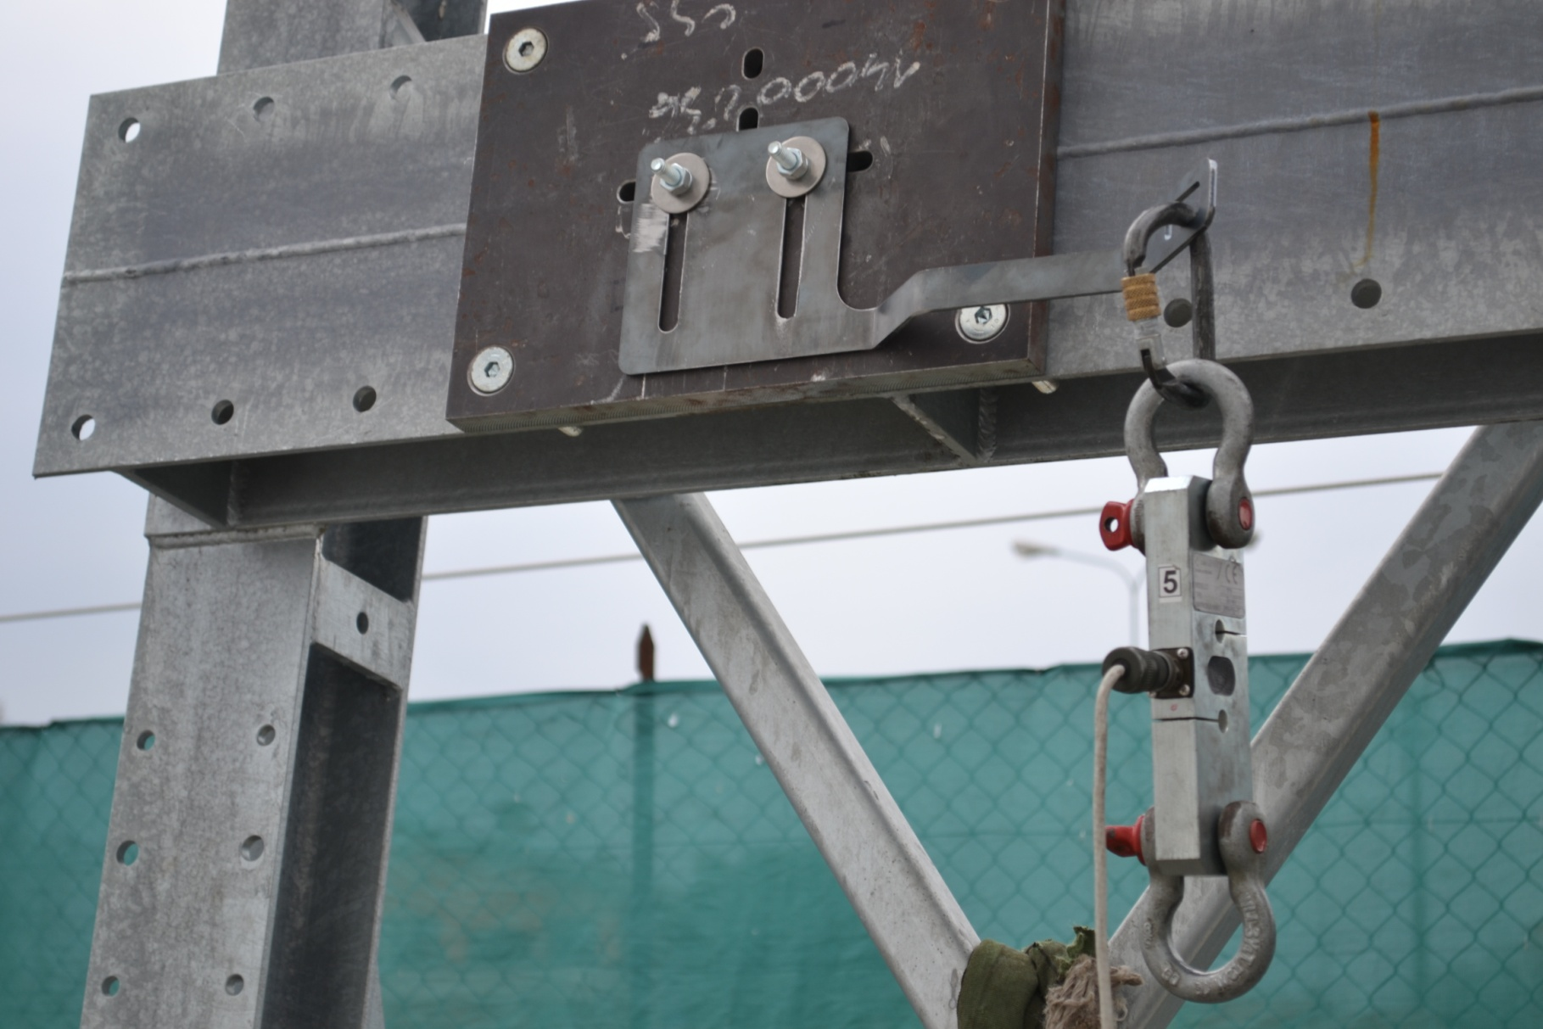
The Chassis
It can accept anchor devices with direct installation (through fixtures)

Slide 10
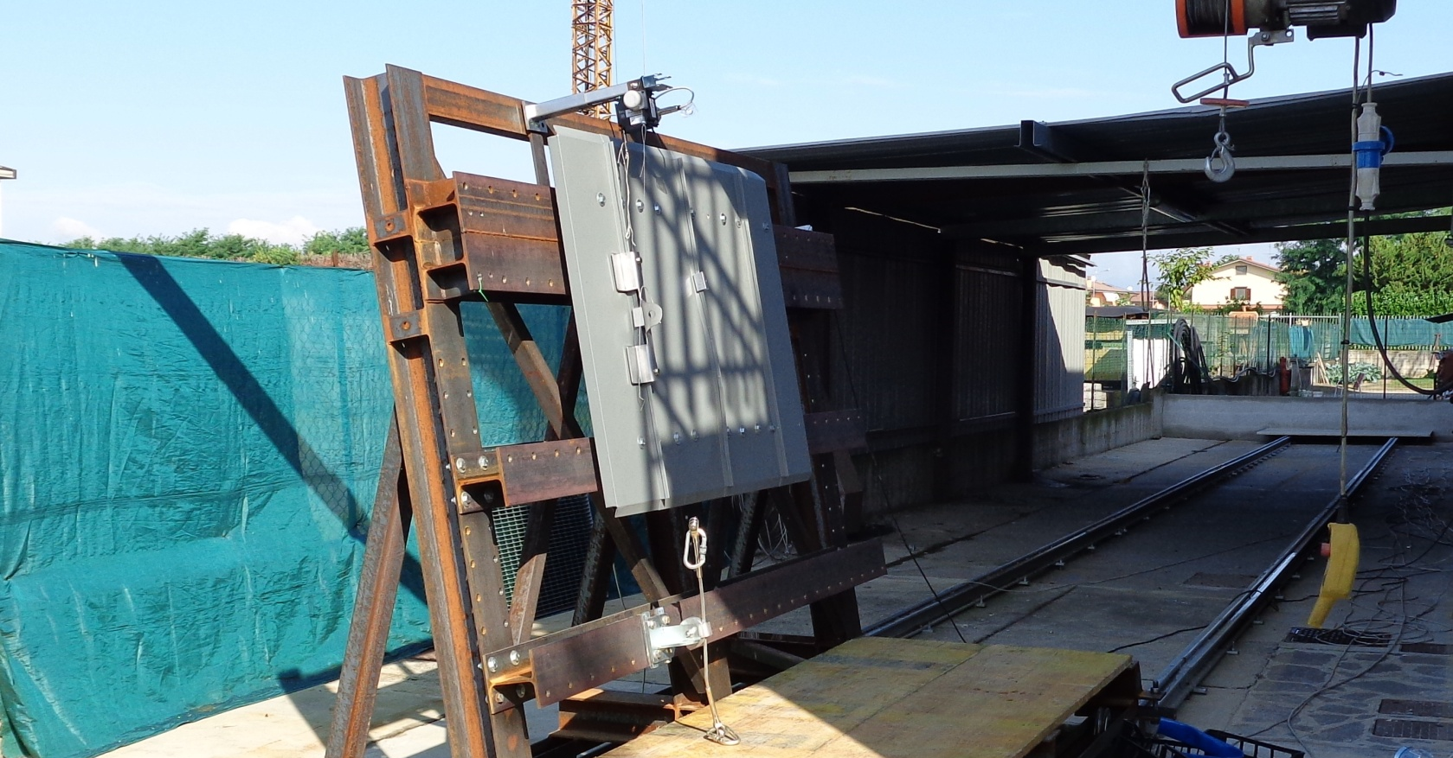
The Chassis
It can accept anchor devices instal-led on panels up to 1440x2500 mm

Slide 11
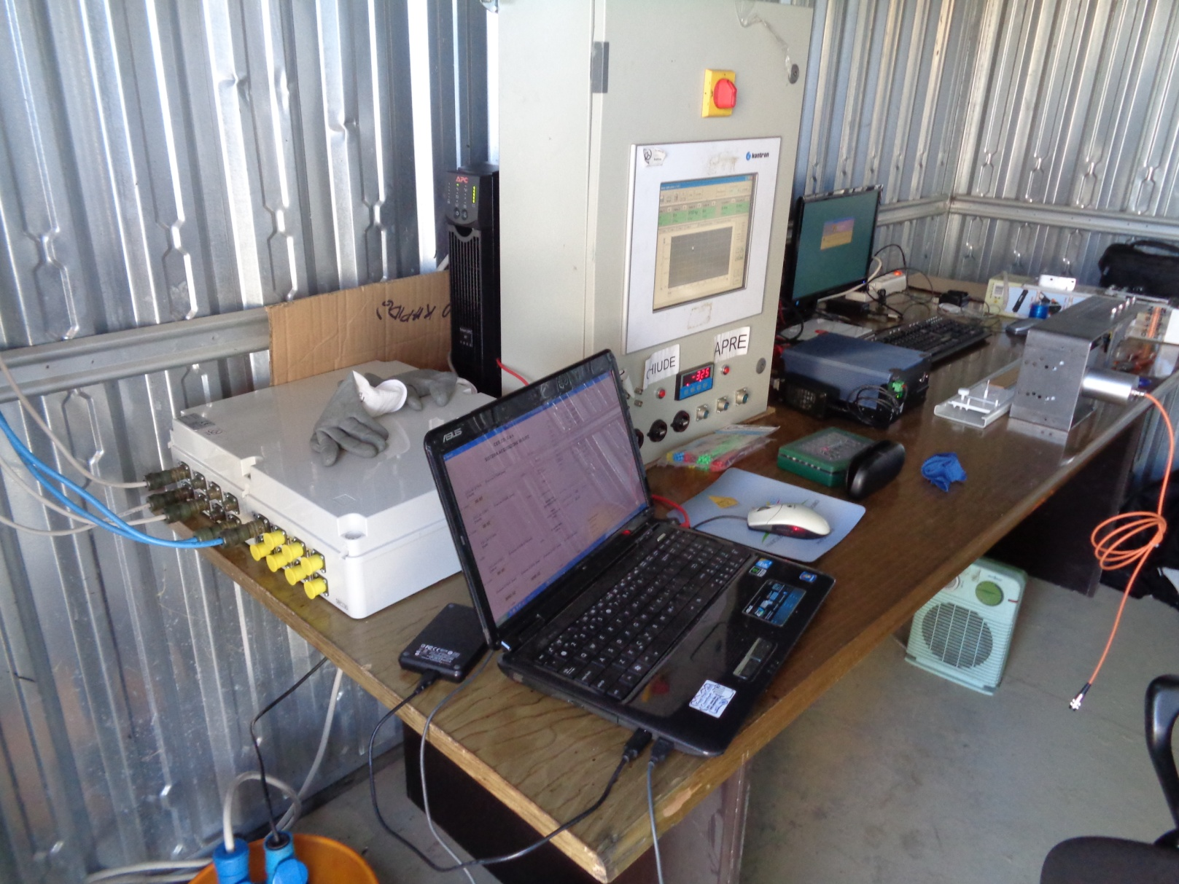
The test apparatus
Picture taken during tests on site

Slide 12
The test apparatus
Hi-Speed DAC board
Several load cells 60 kN, 30 kN, 20 kN, 5 kN (class 1 or 0.5 according to ISO 263) and others to come
Hi-speed long displacement transducers (Microε, Waycon) with resolution < 1 mm
Several short displacement transducers with resolution 0.01 mm
Test lanyards Skylotec X-Trem (EN 892 9.0 kN)
Test masses 200 kg, 100 kg (EN 364), 102 kg
Electronically controlled quick release device

Slide 13
The DAC board

Slide 14
The DAC board
Hi-Speed Eagle PCI 703 (400 ks/s multiplexed) with 16 channels and a 14 bits A/D converter
4 channels dedicated to load cells
12 channels with direct reading (-10/+10V)
Up to 16 channels recordable contemporarily with speed up to more than 10 kHz per channel
Filters implemented for Hi-Speed according to EN 364 and CNB/P/11.024 rev. 03 (for industry) and EN 892/ISO 6847 (for mountaneering equipment)

Slide 15
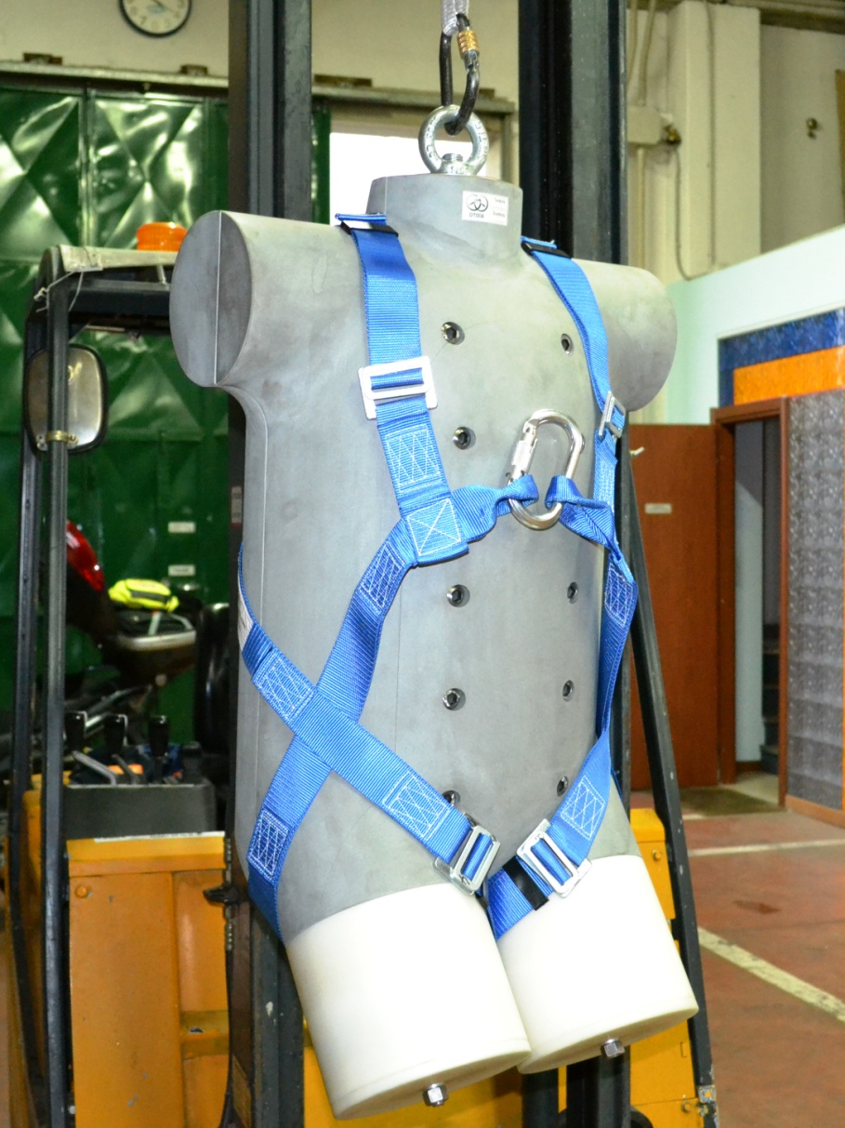
Other test apparatus

Slide 16
Other test apparatus
Ultra freezer for thermal conditioning down to -45°C (testing against EN 354, EN 353-1 at -30°C)
Torso dummy (EN 364) with variable mass from 100 kg to 150 kg (actually static tests ONLY)
Test cylinders diameter 250 mm and 350 mm for static testing against EN 358
Others

Slide 17
Tests performed
EN 795:2012 type A, B, C, D (no corrosion test)
CEN/TS 16415:2013 type A, B, C, D
EN 795:96+A1:00 class A, B, C, D
EN 517:2006
EN 12951:2004
EN 14122-3:2001+A1:2010
EN 358:1999 (lanyards full, belts only static)
EN 361:2002 (only static)
EN 353-2:2002 (no optional requirements)
EN 354:2010
EN 355:2002
EN 360:2002
Others

Slide 18
Tests to come
EN 353-1:2014
EN 361:2002 Dynamic tests with dummy up to 150 kg mass
EN 358:1999 Dynamic tests with dummy up to 150 kg mass
prEN 358 by WG
prEN 360 by WG
Mountaneering equipment
Others in the fields of diving equipment and respiratory protective devices (high and medium pressure test bench)
Others in other fields

Slide 19
CER.CO.SAS TESTING DEPARTMENT
CER.CO.SAS di Fabio Galimberti
TESTING DEPARTMENT
Viale del Lavoro, 22 - 24050 Spirano - BG - Italy
www.en795lab.it - info@en795lab.it
Tel +39 035 0778678 Fax +39 035 0778679 Mob +39 347 5510311
HEAD OFFICES
Via Puccini, 60 - 20099 Sesto San Giovanni - MI - Italy

